Slide 1
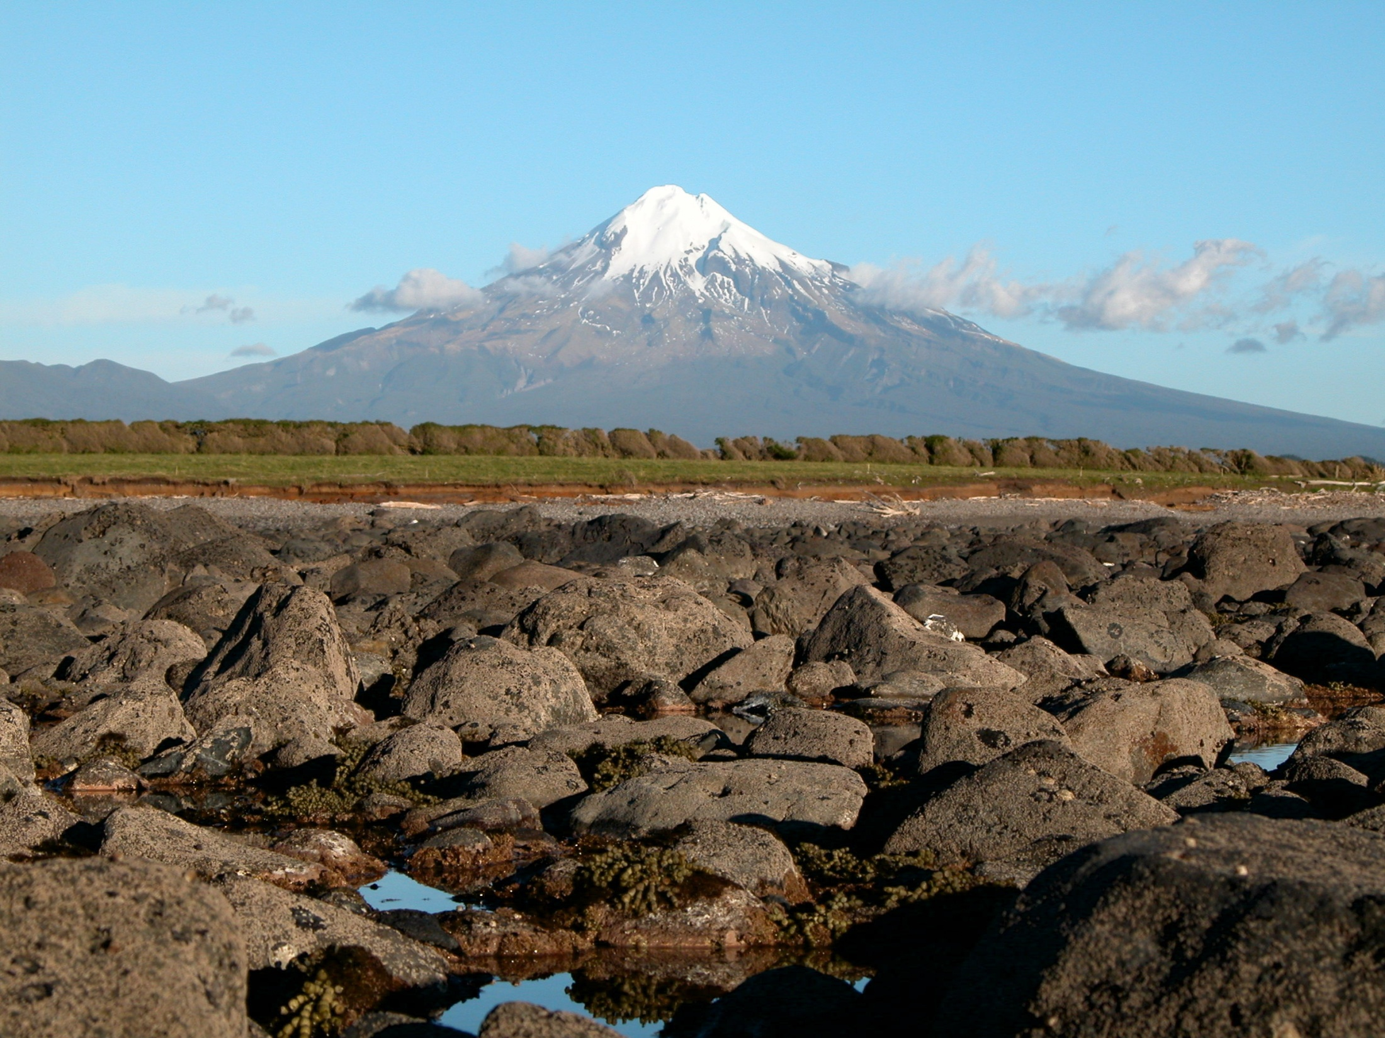
Assessing the Impacts of
Petroleum & Minerals Extraction
- A Taranaki Perspective
11 December 2012

Slide 2
Overview I Tangata Whenua Experience – A Taranaki Perspective I
Taranaki in a Snapshot
Assessing Impacts on Iwi
Some Realities
Some Lessons
Notes:
Presenting ‘a’ Taranaki perspective rather than ‘the’ Taranaki perspective
Based on personal involvement in:
Taranaki iwi/hapu environmental issues
Taranaki Treaty settlement mahi
Living with a legacy of raupatu

Slide 3
TARANAKI IN A SNAPSHOT

Slide 4
Taranaki in a Snapshot I Tangata Whenua Experience – A Taranaki Perspective I
Total Land area of 723,610 hectares (3% of New Zealand's total land area)
All land was subject to Raupatu within the Taranaki confiscation line
Iwi of Taranaki suffered some of the most severe grievances in the country and most serious Treaty breaches in the country
Eight identifiable iwi within Taranaki
Four Treaty settlements and three iwi negotiating Agreements in Principle

Slide 5
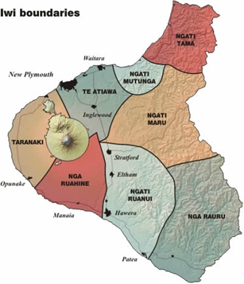
Taranaki in a Snapshot I Tangata Whenua Experience – A Taranaki Perspective I

Slide 6
Taranaki in a Snapshot I Tangata Whenua Experience – A Taranaki Perspective I
First well drilled in Taranaki in 1865
Petroleum continuously produced from Taranaki basin since about 1900
Modern era of exploration/production began in 1959
Over 400 onshore and offshore wells drilled since 1955 in Taranaki

Slide 7
Taranaki in a Snapshot I Tangata Whenua Experience – A Taranaki Perspective I
All of New Zealand’s current producing oil and gas fields are located in the Taranaki basin
Most of the basin is offshore, although majority of producing fields onshore
When Maui field discovered, it was one of the largest gas fields in the world

Slide 8
Taranaki in a Snapshot I Tangata Whenua Experience – A Taranaki Perspective I
Petroleum Report 2003
Tribunal Recommendations
Claimants entitled to redress beyond which their historical and land loss grievances entitle them
Any of the Crown’s remaining petroleum assets ought to be on the table in any settlement negotiations with affected claimants
Has general application but applies with particular force in Taranaki

Slide 9
Taranaki in a Snapshot I Tangata Whenua Experience – A Taranaki Perspective I
Management of Petroleum Report 2010
Tribunal Recommendations
Legislative changes to Crown Minerals Act 1991
Fundamental changes to tangata whenua involvement in decision making processes
Development of enforceable environmental protection system for EEZ
Development of national policy statement and national environmental standards

Slide 10
ASSESSING IMPACTS ON IWI

Slide 11
Assessing Impacts on Iwi I Tangata Whenua Experience – A Taranaki Perspective I
Early Engagement
Early Information Sharing
Early Engagement
Early Information Sharing

Slide 12
Assessing Impacts on Iwi I Tangata Whenua Experience – A Taranaki Perspective I
Don’t assume anything
Do your homework – know who you are engaging with
Build relationships
Recognise constraints and create solutions

Slide 13
Assessing Impacts on Iwi I Tangata Whenua Experience – A Taranaki Perspective I
Impacts on Iwi run far deeper and wider than pure physical impact
How do you assess non-physical impacts?
How do you mitigate such impacts?

Slide 14
SOME REALITIES & LESSONS

Slide 15
Some Realities I Tangata Whenua Experience – A Taranaki Perspective I
Taranaki realities
The rest of the country is where Taranaki was at 20-30 years ago
Limited resources and capacity
Crown rejection of Wai 796 Tribunal Report
Petroleum & Minerals off the negotiating table
Have been fighting for generations

Slide 16
Some Realities I Tangata Whenua Experience – A Taranaki Perspective I
Taranaki realities
Somewhat in damage control mode
Although over 400 well sites within Taranaki, thousands of other sites (pipelines etc)
Present focus on protection of whenua and other resources
Classification of wahi tapu
Resolution of historical grievances

Slide 17
Some Lessons I Tangata Whenua Experience – A Taranaki Perspective I
Early Engagement
Early Information Sharing
Know who you are engaging with

Slide 18
Questions I Tangata Whenua Experience – A Taranaki Perspective I

