Slide 1
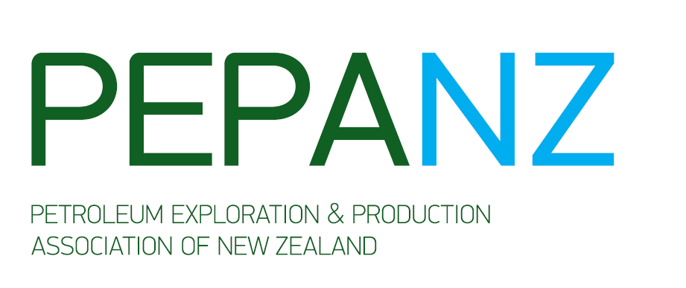
NZAIA 2012
Conference
Assessing the impacts of coming developments
David Robinson, CEO, PEPANZ

Slide 2
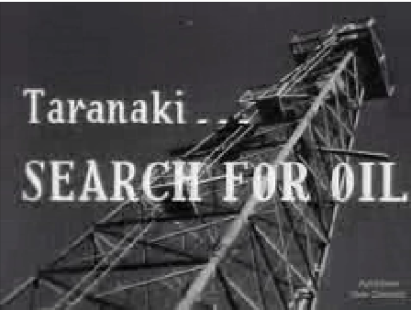
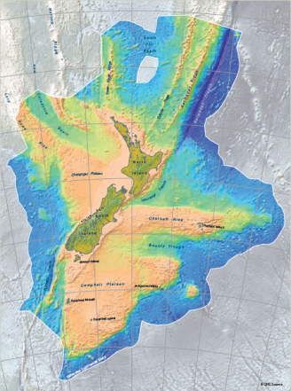
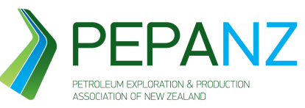
Oil and gas in New Zealand
For nearly 150 years the oil and gas industry has operated in Taranaki without major incident.
The industry is very much part of the community and the public are used to having the oil and gas sector operating within their towns.
But times are changing – the oil and gas industry is looking to explore new frontier basins and increase its operations here in New Zealand.
The biggest impacts of this development have been felt by the industry itself.

Slide 3
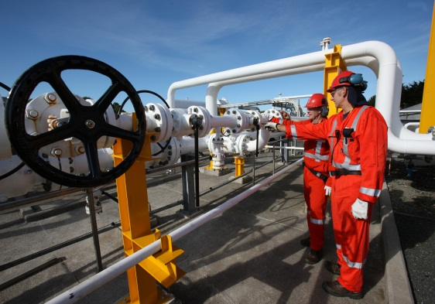
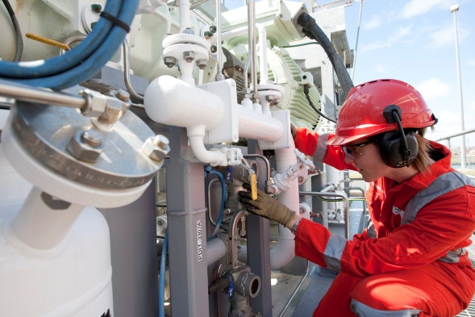
Doing things differently
We know, as an industry we need to do something's differently:
Building relationships with Communities
Being open and transparent
Good regulation, high standards and world class health and safety policy

Slide 4
Building relationships with Communities: What we know

Slide 5
Energy literacy – a big part of our energy future
Keeping communities informed about New Zealand’s energy mix
Wind is the fastest growing renewable. But transmission and backup generation may be limiting factors
Oil built the prosperity of the 20th century. Oil is virtually our only transport fuel – and right now we have nothing to replace it. The transition away from oil completely is still not viable
Geothermal: Where there's high temperature near the surface, it's a fantastic resource
Natural gas is versatile, abundant and cleaner, but still has an environmental footprint
Nuclear energy – not in our country
Coal electricity is abundant and relatively cheap.
Biofuels may play an expanding role depending on technology, cost and land use
Solar is very clean, very expensive, lacks scale
Hydro was the ideal electricity resource - but also has an environmental footprint

Slide 6
No such thing as oil rigs on the coast overnight
Seismic testing through to production can take between 7-15 years
Fundamental principle has not changed:
9 out of 10 wells are dry (dusters)
The biggest risk is lose all your money

Slide 7
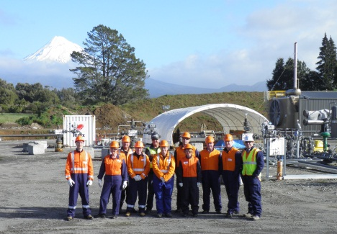
Industry must open its doors We need to be open and transparent with New Zealanders
Taranaki Tours
Dale Booth: “The tour was fantastic and a great chance to see the industry up close, something that I knew very little about until now. It was fascinating to see the impact the oil industry has had on the local economy, (which appears to be all positive) something that we are all very interested in down in the Deep South.

Slide 8
Fact not fiction: important part of the debate
As an industry we do stand by our track record. We believe we have nothing to hide, and strive to be open and transparent about our operations in NZ.
But as our research shows not many New Zealanders have seen an oil rig or a well pad – when they think of the oil and gas industry international incidents like the gulf of Mexico come to mind.
We need to start talking about the facts
Parliamentary commissioner of the Environment’s report into Fracking
The UK Royal Society’s report into hydraulic fracturing.
Need to take the middle road, and have a reasonable conversation with all the facts on the table

Slide 9
Royal Society Report
UK’s chief scientific advisor asked the Royal Society and the Royal Academy of Engineering to review the scientific and engineering evidence related to risks associated with the practice of hydraulic fracturing
The report finds:
‘the health, safety and environmental risks associated with hydraulic fracturing (often termed ‘fracking’) as a means to extract shale gas can be managed effectively in the UK as long as operational best practices are implemented and enforced through regulation.’
A very significant and authoritative statement - should be allowed to fully inform the current national discussion.
Report also contains a series of recommendations
TRC reconciliation of recommendations showed Council and NZ are well-positioned to demonstrate good practice in management and regulation

Slide 10
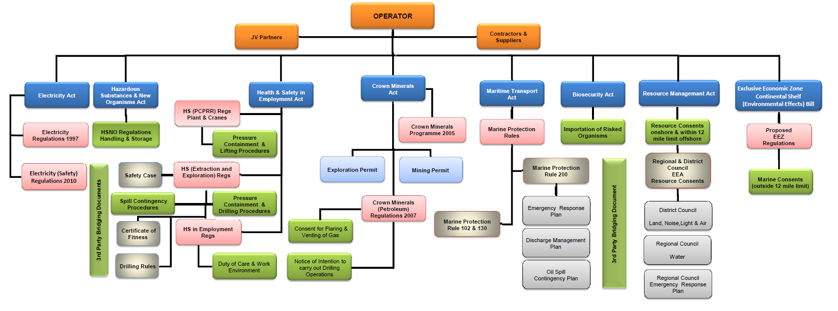
Heavily regulated: but never complacent

Slide 11
Workers have their say
Play PEPANZ video

Slide 12
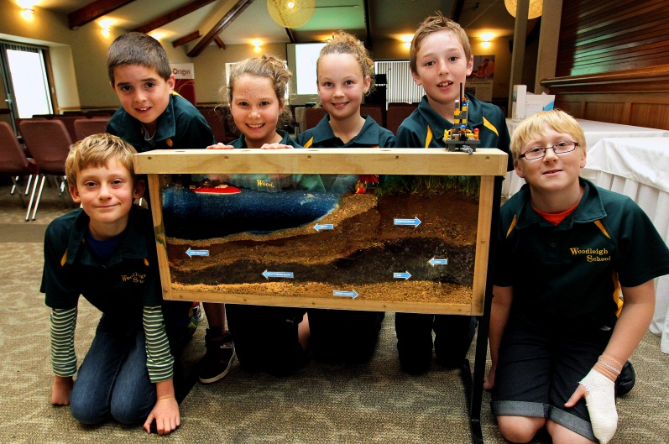
Huge contribution to NZ
$1b in royalties and company taxes
7000 jobs
4th largest export earner
And we have the potential to do more!

Slide 13
