Slide 1

Social Impact Assessment of Resources Projects
NZAIA Conference ‘Assessing the impacts of petroleum & mineral extraction in New Zealand’, Wellington, 11 December, 2012
Dr Daniel Franks
Co-Chair SIA, International Association for Impact Assessment
E:
d.franks@uq.edu.au
@resourceafflict

Slide 2
Overview
Addressing Social Impacts: Why is this important?
The Costs of Getting it Wrong
Social Impact Assessment: The Premise
Innovations in Policy & Practice
Observations on Unconventional Gas Development
Notes:
Deliberately extend SIA thinking from the regulatory context…

Slide 3
Addressing Social Impacts– Why is this important?
A policy environment that encourages social impact assessment and management is important to:
ensure developments that proceed contribute to economic growth, social development and environmental protection
provide opportunity for participation, information for decision making, and platform for project improvement
reduce social risks & business risks: provide greater certainty for investors, government, and society
attract experienced & capable companies
increase long-term success and avoid delays, shutdowns, and even the closure of projects

Slide 4
Social and Cultural Change | human rights population and demographics culture and customs community identity crime and social order community health and safety social infrastructure and services
Economic Change | local economy and other industries housing sustainable livelihoods employment inflation/deflation
Socio-environmental Change | access/competition for resources ecosystem change pollution (air, water, noise, vibration, traffic) disturbance/amenity cultural heritage
The Process of Change | consultation & communication consent participation governance and agreements redress and dispute resolution
(Franks, 2011)

Slide 5
Issues in Dispute
(Source: Franks and Davis, forthcoming)

Slide 6
Operating Stage
(Source: Franks and Davis, forthcoming)

Slide 7
COSTS OF MINE-COMMUNITY CONFLICT
Most frequent costs: lost productivity due to delay.
A US$3-5 billion project will suffer roughly US$20 million per week of delayed production in (NPV) terms.
Greatest costs: inability to pursue projects.
Esquel (2006) $US379m asset write down on $US1.33b reserves
Tambogrande (2003) $US59.3m asset write down on $US253 reserves
Conga (2011) – suspended during construction – majority owner (51.35%) spent $US900m in past 3 years.
Most often overlooked costs: additional time of senior management.
(Franks and Davis, forthcoming)
Notes:
Slide with formula/table for calculation and include example data

Slide 8
84 REPORTED FATALITIES (1/10/11 – 30/9/12)
Marikana | South Africa | 45
Grasberg | Indonesia | 13
Conga | Peru | 5
Zogota | Guinea | 5
Implats | South Africa | 3
Tintaya/Antapaccay | Peru | 3
North Mara | Tanzania | 2
Bima | Indonesia | 2
Tonkolili | Sierra Leone | 1
Collum | Zambia | 1
Markham - Tibet | China | 1
El Hatillo | Colombia | 1
Malku Khota | Bolivia | 1
Pierina | Peru | 1
(Franks and Davis, forthcoming)
Notes:
Slide with formula/table for calculation and include example data

Slide 9
Impact Assessment – The Basic Premise
That by understanding the environmental & social context and using participatory and technical methods to predict and/or evaluate change better decisions can be made and better projects designed and implemented.
Notes:
Useful to revisit

Slide 10
What is Social Impact Assessment?
SIA is the processes of analysing, monitoring and managing the intended and unintended social consequences, both positive and negative, of planned interventions (policies, programs, plans, projects) and any social change processes invoked by those interventions (Vanclay, 2003).
SIA has transcended its original formulation as a technique for predicting social impacts as part of regulatory approval processes.
SIA discerns between social change processes and the experience of impacts

Slide 11
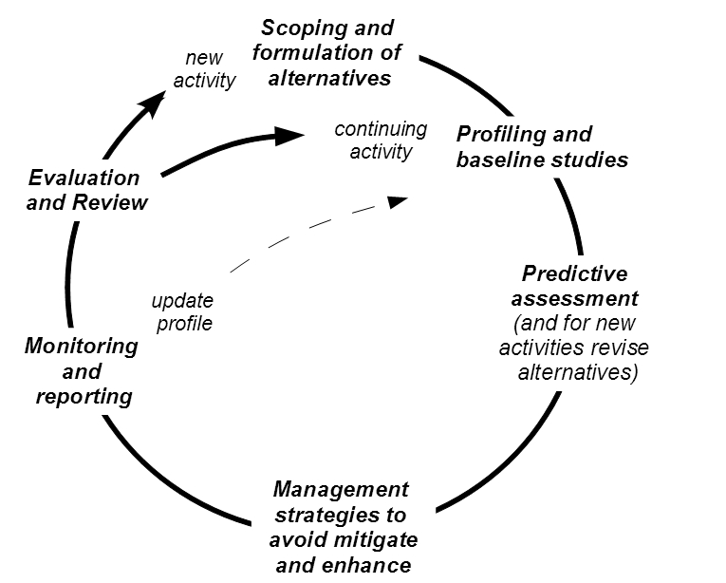
Social Impact Assessment
There is a lot of overlap with what we might think of as ‘Community Relations’ or ‘Social Performance’ functions.
Community Engagement & Participation
Free Prior & Informed Consent
Baselines
Grievance Mechanisms
Environmental Impact Statement
Community Trusts & Funds
Impact & Benefit Agreements
Community Relations/Management Systems
Social Impact Management Plan
Community Consultative Committees

Slide 12


Initiative – Social Management Plans (IFC Performance Standards/Equator Principles)
How does it work? – are a condition of project financing for IFC funded projects
Initiative – Socio-Economic Assessment Toolbox (Anglo American; adapted by Shell)
How does it work? – processes to support social impact management with requirement to undertake every 3 years
Notes:
Anecdote about WA - Gorgon

Slide 13
Initiative – Social Impact Management Plans
Jurisdiction – Queensland
Aim – Improve socio-economic development of mining regions
How does it work? –SIMPs are developed by the proponent and submitted with EIA approvals process; negotiated with government agencies
Set out a plan of how company will address social issues throughout life of project including delivery of commitments.
Challenges – Designed to link with regional planning but in practice weak
e.g. SIMP: http://www.qgc.com.au/media/95675/qclng-simp.pdf

Slide 14
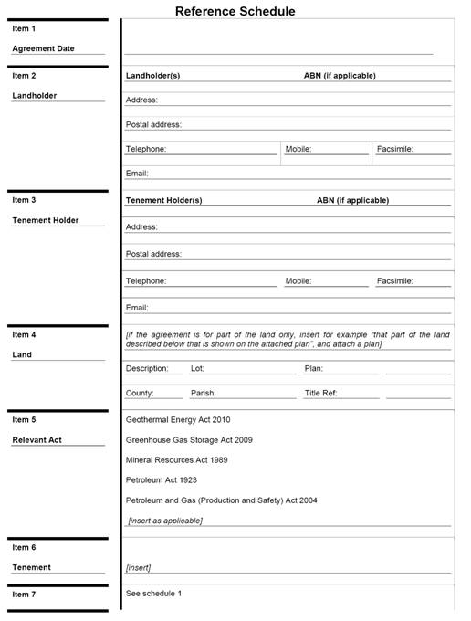
Initiative – Conduct and Compensation Agreement
Jurisdiction – Queensland, Australia
Aim – Encourage agreement between landholders and exploration companies prior to exploration
How does it work? – Agreement required by state; outlines a company’s activities and any compensation for disturbance; requires parties to meet in person; template provided by government
Challenges – Does not always solve disagreements

Slide 15
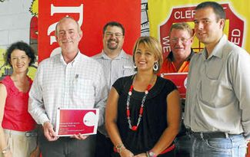
Case – Community Consultative Committees
Jurisdiction – New South Wales
Aim – Improve the communication and participation of key stakeholders with mining operations
How does it work? – Reference panel established with representative stakeholders. Quarterly meetings, independent chair with company representation
Challenges – The representation of stakeholders. Moving beyond just communication.
http://www.planning.nsw.gov.au/assessingdev/pdf/ccc_guidelines_dft_7.pdf
http://www.planning.nsw.gov.au/assessingdev/pdf/ccc_guidelines_2007.pdf

Slide 16
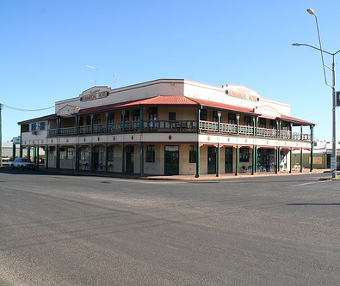
Initiative – Clermont Preferred Futures
Jurisdiction – Queensland, Australia
Aim – Facilitate a community regional planning initiative in response to local requests for infrastructure investment
How does it work? – Develop future economic strategy.
Supported by socio-economic research & community participation in visioning process.
Collaboration between Rio Tinto and Isaac regional council.
Jointly funded officer to implement investments
Challenges – Significant investment in time and resources.

Slide 17
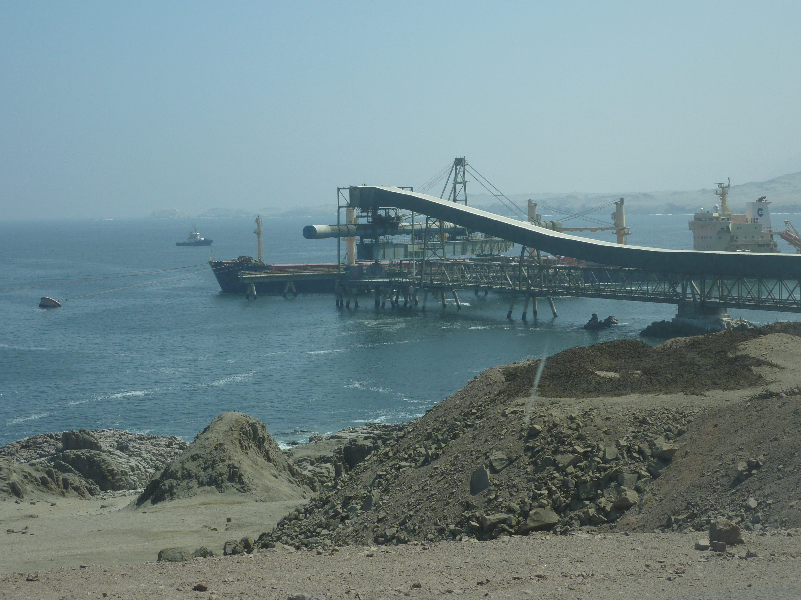
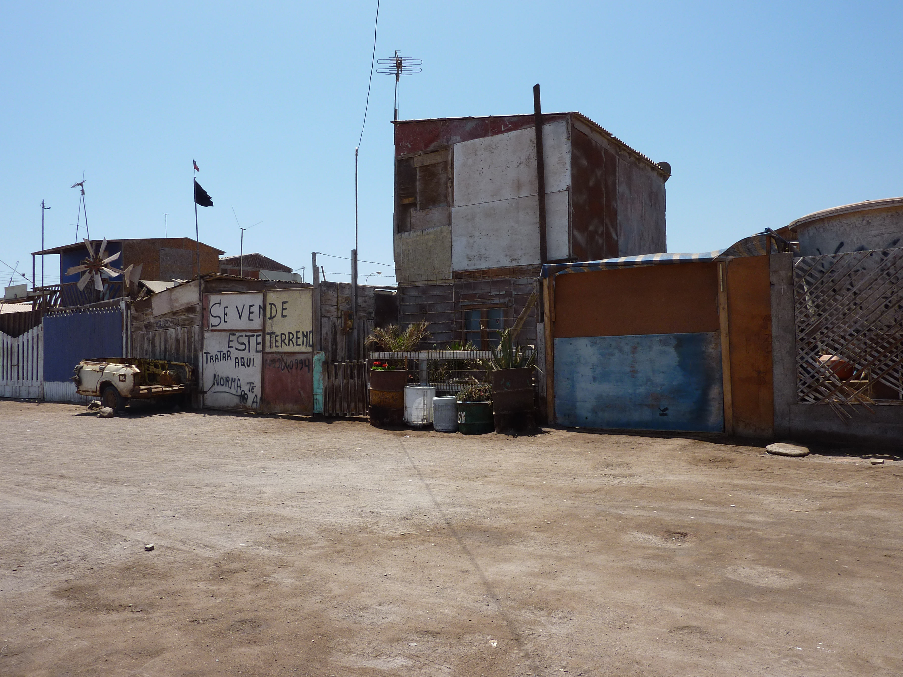
Initiative – Collahuasi Community Relations Strategy
Location – Tarapaca, Chile
Context – Odour emissions from port facility; particular community not identified as important stakeholder; conflict escalation; introduction of community relations capability
Response – undertake SEAT; complaints process; re-direct social investments to be strategic; develop internal management system.

Slide 18
Collahuasi: social program selection criteria
Does the project respond to an identified community need? (e.g. as identified by SEAT baseline, or ‘Mesa de Trabajo’)
Are the intended project recipients involved in a) the development of the idea; b) the design of the project; and c) the delivery of the project?
Does the project build community independence and a lasting legacy?
Does the project benefit a priority community?
Has the project been subject to a formal selection or prioritisation process?
Does the project respond to a priority strategic risk area (for company or community)?
Does the project advance relationships with a strategic stakeholder group?

Slide 19
Risk

Slide 20
Risk
Proportion of spending where issue has been identified as:
High risk (environment & indigenous) | 2.7%
Medium risk (enterprise development, education, social development) | 27.8%
Low risk (sport, arts & culture, community health | 69.5%

Slide 21
Strategic Value
(without spending for Tarapaca region and Santiago)

Slide 22
Population
(without spending for Tarapaca region and Santiago)
Notes:
Expected Population Spend = Total (less region wide and Santiago spending)/Total Population (less Santiago) x Location Population
Proportion of Population Spend = Actual Spending/Expected Population Spend x 100
Results for some localities reported together (e.g. Chanavayita & Caletas Pesqueras) due to reporting categories of spending data.
In practice the strategic impacts of co-reported projects are similar and were averaged to gain an approximate figure.

Slide 23
Observations on Unconventional Gas
Dispersed geological resource
Landscape scale
Co-existence (vs. separation)
Issues at multiple geographic and temporal scales
Cumulative impacts / governance
Land-use and identity
Custodian vs. sovereign
Access & agreement making
Exploration impact or prospect of development?
New alliances, new activists
Social infrastructure, growth, land access, climate & emissions, water, amenity, identity, health, employment
Technology innovation
Environmental change under ‘geological cover’
Experts and knowledge
New and contested languages: CSG ‘Mining’, ‘Fracking’, ‘Transition Fuel’, ‘Adaptive Management’ vs. ‘Precautionary’
Economic implications – the location of benefit, the value proposition, LDC.

Slide 24
Summary
Constructive community relationships are critical to the success of projects.
There are increasing expectations from communities for greater involvement in decision-making, transparency, and more equitable balance of risks and benefits.
A policy environment that encourages constructive community relationships will reduce project risk and attract experienced & capable companies.
Notes:
Deliberately extend SIA thinking from the regulatory context…

Slide 25
E:
d.franks@uq.edu.au
@resourceafflict
csrm.info
Franks, DM. 2011. Management of the Social Impacts of Mining. In P Darling (Ed.). SME Mining Engineering Handbook. Society for Mining, Metallurgy, and Exploration. Colorado. Chapter 23.4. (pp. 1817-25)
Franks, DM et al., 2011. Cumulative social impacts. In F Vanclay and AM Esteves (eds). New Directions in Social Impact Assessment: Conceptual and Methodological Advances. Edward Elgar Press. (pp. 202-220)
Esteves, A. M., Franks, DM., & Vanclay, F. 2012. Social Impact Assessment: The State of the Art. Impact Assessment and Project Appraisal. http://www.tandfonline.com/doi/pdf/10.1080/14615517.2012.660356
Franks, DM. 2012. Social Impact Assessment of Resource Projects. Mining for Development: Guide to Australian Practice. International Mining for Development Centre, Australian Agency for International Developmenthttp://im4dc.org/wp-content/uploads/2012/01/UWA_1698_Paper-02_Social-impact-assessment-of-resource-projects1.pdf
Franks, DM, Brereton, D, Moran, CJ, Sarker, T and T, Cohen. 2010. Cumulative Impacts - A Good Practice Guide for the Australian Coal Mining Industry. ACARP
http://www.csrm.uq.edu.au/docs/CSRM%20SMI%20Good%20Practice%20Guide%20document%20LR.PDF
Franks, DM, Everingham, J. & Brereton, D. 2012 Governance Strategies to Manage and Monitor Cumulative Impacts at the Regional Level. ACARP. http://www.csrm.uq.edu.au/Portals/0/C19025FinalReport.pdf
Franks, DM, Fidler, C, Brereton, D, Vanclay, F and P, Clark. 2009. Leading Practice Strategies for Addressing the Social Impacts of Resource Developments. Queensland Department of Employment, Economic Development and Innovation. http://www.csrm.uq.edu.au/docs/Franks_etal_LeadingPracticeSocialImpacts_2009.pdf
Publications

Slide 26
SIA – strengths & weaknesses of practice
Proliferation of social specialists but varied influence in shaping project/alternatives (social still a poor cousin?)
Expanded corporate policy, standards & tools. A requirement in more jurisdictions - but SIA in EIS often just ‘good enough’
Data currency and use of primary data – assessments sometimes little more than a profile of census data
Distribution of impacts (space, time and stakeholder)
Integration with environment, health and cultural
Scoping – issue prioritisation
Public participation – ‘period of public comment’
Cumulative impacts, gender, human rights, benefits

