Slide 1
Advances in mitigation and compensation for impacts in freshwater environments
I.K.G. Boothroyd,
Golder Associates (NZ) Limited.,
Takapuna,
Auckland

Slide 2
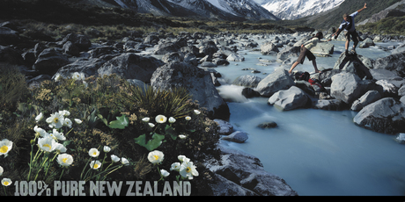
Freshwater environments
Overall, some aspects of water quality have deteriorated in rivers over the past 20 years mainly as a result of farming (pastoral land cover) and environmental gains in terms of reduced ‘point’ pollution of waters in New Zealand are being overshadowed by increasing ‘diffuse’ pollution. NIWA (2010): Water quality trends at NRWQN sites for the period 1989-2007

Slide 3
Freshwater environments IN CRISIS?
Water crisis: Going with the flow
NZ Herald 17 Nov. 2012
Govt hints at charges for water
NZ Herald 16 Nov
'Duty' to raise freshwater issues
Otago Daily Times 4 Dec 2012
Sustainable farm systems needed:
Will we accept firm water quality limits in our agriculture
Otago Daily Times22 Nov 2012
Editorial: 100 Pure critic needs to be fair and accurate NZ Herald Editorial

Slide 4
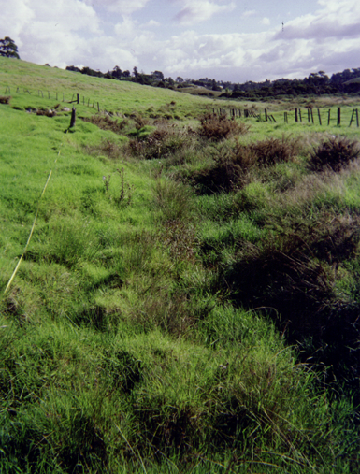

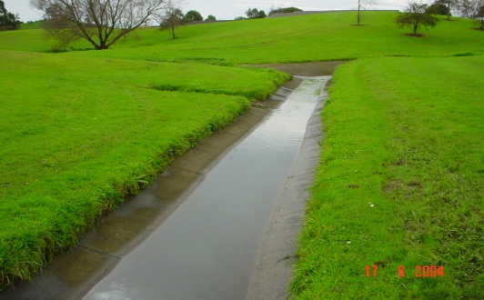
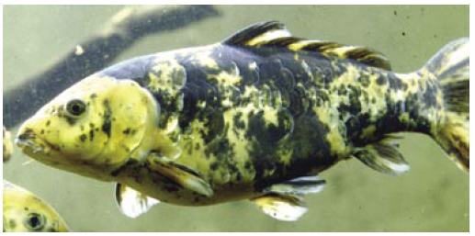
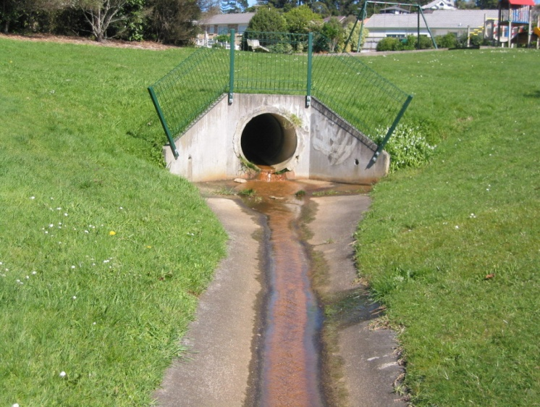
Freshwater environments impacts
Loss of habitat
Degradation of habitat
Enrichment
  Intensification of land
  Use of fertlisers
Invasive species
Stream diversions
Point source
Non-point source
Fish barriers
Riparian management

Slide 5
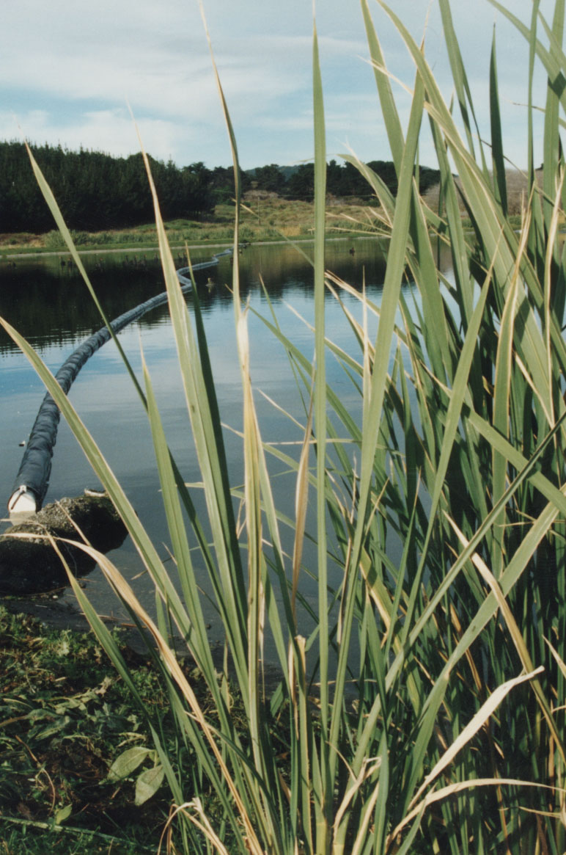
Freshwater environments
Outline
Focus on streams and rivers
Assessing significance in aquatic ecosystems (values)
Ecosystem integrity
Offsets and mitigation
Stream Ecological Valuations (SEV)
Pros and Cons of SEV and aquatic biodiversity offsets
Expert caucusing
Summary

Slide 6
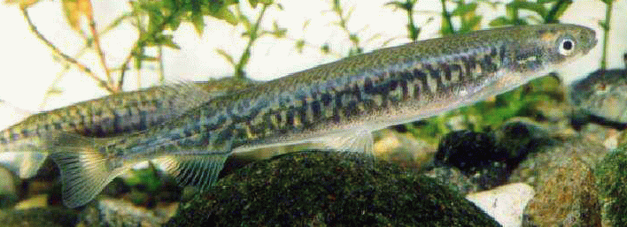
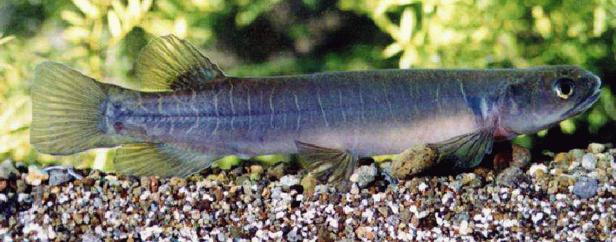
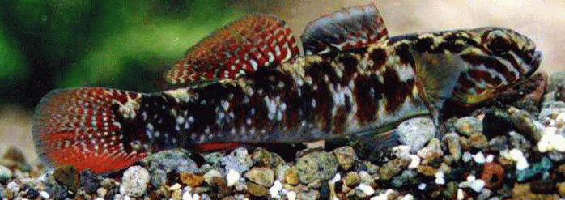
Recent advances
NPS Freshwater Management
NES Ecological Flows and Levels
Land and Water Forum
  Water quality
  Water quantity
  Urban streams
  Iwi
Approaches to assessing ecological integrity of freshwaters
Conservation threat status of native fish
Inanga
Banded kokopu
Red finned bully

Slide 7
Why assess risk – ‘mitigation’ hierarchy
Project impacts
  Avoidance of critical impacts
  (design & operations)
  Minimisation of unavoidable impacts (management & intelligent design)
  Ecological restoration of impact sites:
  (progressive; unlikely to replace loss)
Residual impacts
Additional conservation actions (compensation; including for loss of ecosystem services)
Biodiversity offsetting
Environmental compensation – residual effects that cannot be mitigated – not default position

Slide 8
Valuing aquatic ecosystems
No unifying or nationally accepted approach to assessments of significance or values in aquatic environments
Council significance criteria often not used for aquatic ecosystems or not seen as applicable (generally seen as developed for terrestrial ecosystems)
  Distinctiveness,
  Rarity
  Representativeness,
  Context,
  sustainability etc.
Approaches to assessing ecological integrity of freshwaters

Slide 9
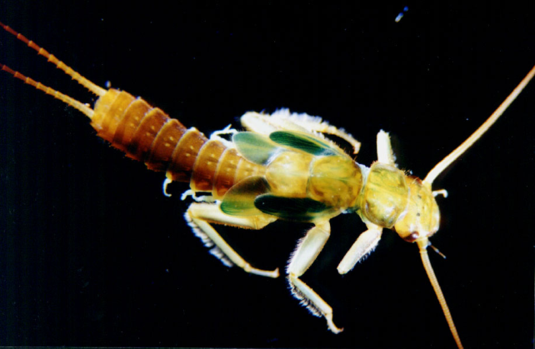
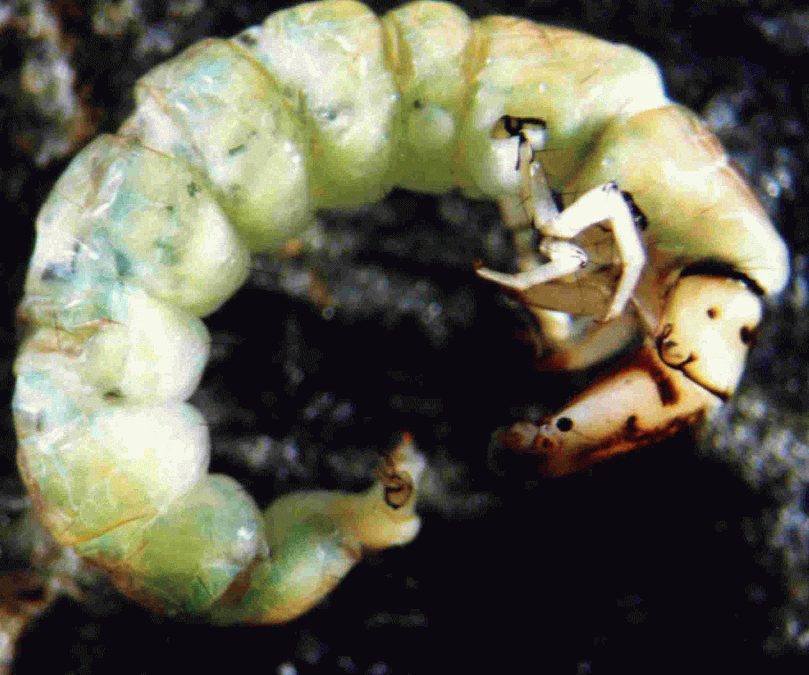
Assessing significance in aquatic ecosystems
Advances in sampling methodology:
  Protocols for sampling macroinvertebrates
  Protocols for stream habitat assessments
  Fish sampling - debate and discussion; IFI
  Standard indices (MCI, EPT)
Use variety of tools or frameworks and databases
  River Environment Classification (LENZ?)
  Areas for protection
  WONI (Waters of National Importance)
  WERI
  NZFFDB
Spiny-gilled mayfly, Coloburiscus
Caddisfly, Hydrobiosis

Slide 10
Assessing significance in aquatic ecosystems
Focus on single or narrow suite of attributes
Focus on single scores/indices
Lack of context, especially geographical location and scale (NPS attempt to overcome this)
Offset mitigation can overshadow the ‘significance’ or ‘value- establishing’ content
Less relevance as get closer to decision-making process exercise?

Slide 11
Ecosystem health and integrity
Ecosystem health is indicative of the preferred state of sites that have been modified by human activity, ensuring that their ongoing use does not degrade them for future use.
Ecological integrity is fully realised when human actions have little or no influence on sites and when the biological community reflects the influence of ecological, rather than human, processes.
‘… the ability to support and maintain a balanced, integrated, adaptive biologic system having the full range of elements and processes expected in the natural habitat of a region.’ Karr 1996

Slide 12
Ecosystem integrity
Nativeness - the degree to which an ecosystem’s structural composition is dominated by the indigenous biota characteristic of the particular region.
Pristineness - relates to a wide array of structural, functional and physico-chemical elements (including connectivity), but is not necessarily dependent on indigenous biota constituting structural and functional elements.
Diversity - richness (the number of taxa) and evenness (the distribution of individuals amongst taxa); link to a reference condition?; the use abundance weighting?; and geographical scale.
Resilience (or adaptability) - quantifying the probability of maintaining an ecosystem’s structural and functional characteristics under varying degrees of human pressure.
(From: Schallenberg et al. 2010: Approaches to assessing ecological integrity of New Zealand freshwaters.

Slide 13
Mitigation and Offsets
Offsets unfamiliar term for use/loss of aquatic resources (exception of wetlands)
‘No net loss’ policies (especially wetlands)
‘Like for Like’ assumption
Mitigation as an expert opinion/weight of evidence
Expert judgements and Expert caucus
Expert settlement is a driver as get closer to decision-making process exercise
No net loss vs Net gains
Manage impacts on-site
On-site vs Off-site compensation (residual impacts)

Slide 14
Stream Ecological Valuation (SEV)
Stream Ecological Valuation (SEV): a method for scoring the ecological condition of Auckland streams and for quantifying environmental compensation ARC Technical Publication
  Existing approaches varied, subjective and inconsistent
  Loss of stream habitat in Auckland
  Provides a standard method
      Robust, empirical
      Comparable, repeatable

Slide 15
Loss of stream length (consented; Auckland)
Financial year | Stream Length (m)
1999-2000 | 9,197
2000-2001 | 11,368
2001-2002 | 11,961
2002-2003 | 11,035
2003-2004 | 7,058
2004-2005 | 12,159
2005-2006 | 7,146
2006-2007 | 3,669
2007-2008 | 7,146
Nine year mean = 8,971 m; total = 80,739 m (~ 80 kms)
NB excludes Permitted activities and Category 2 stream

Slide 16
Stream Ecological Valuation (SEV)
Stream functions
  Universal to all stream types
  Holistic assessment of ecological condition
  Incorporating measures of state of the environment
  Sixteen functions in 4 broad categories
  Hydraulic functions (e.g., flow regime, connectivity to floodplain, connectivity to groundwater).
  Biogeochemical functions (e.g., water temperature, dissolved oxygen, organic matter)
  Habitat functions (e.g., fish spawning habitat, habitat for aquatic fauna).
  Biodiversity functions (e.g., fish fauna, invertebrate fauna, biodiversity, riparian vegetation).
Ecological Compensation Ratio (ECR)
(SEVi-P – SEVi-I) / ((SEVm-P – SEVm-C) x 1.5)
Notes:
The philosophy of the method is that measurement of the performance of stream functions.
This allows not only the assessment of what is currently in the stream, but also how well the stream is functioning. Healthy ecosystem functioning should be the target in stream management.
Functions are universal to all stream types and therefore can be directly compared – different structures may perform same functions in different stream types.
The range of functions allows a holistic assessment of ecological performance, which incorporate traditional measures of state.

Slide 17
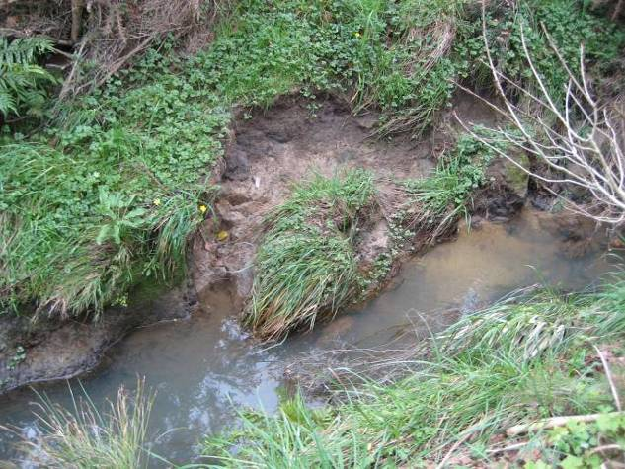
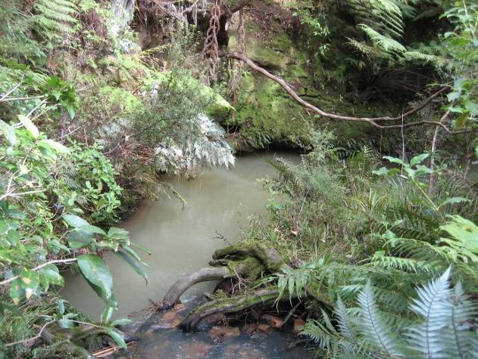
Environmental Compensation
0
0.4
0.8
1
SEV
Consider offsite
Favour onsite
No Go
Favoured EC range

Slide 18
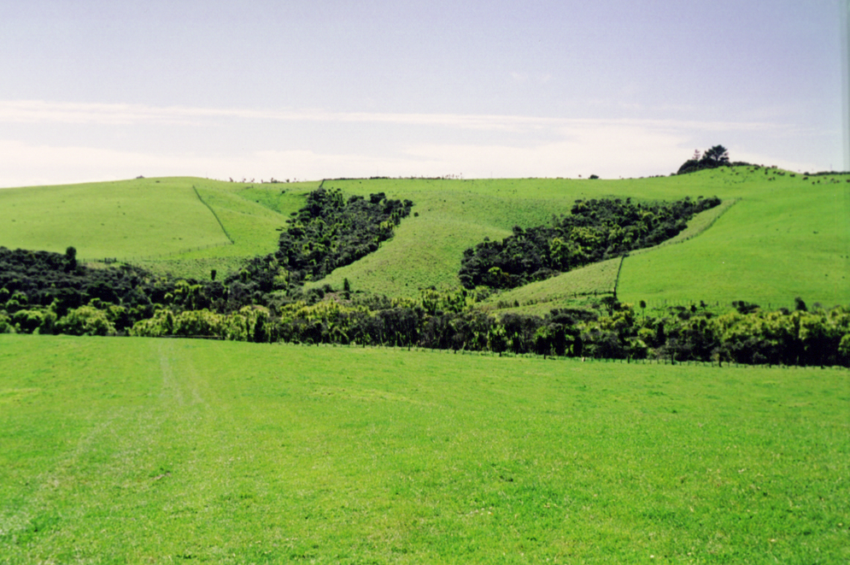
Riparian zone planting and management

Slide 19
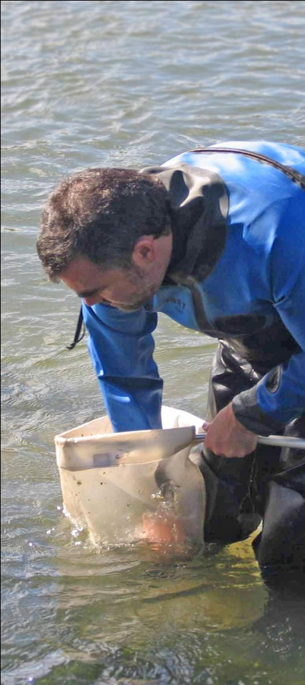
Benefits of environmental compensation
Standard methodology
Based on credible systems used overseas
Accepted practice in Auckland
Applies to all permanent streams (not intermittent or ephemeral streams)
General policy framework applies (no net loss)
Largely unchallenged at higher levels of decision-making but increasing
Other compensation mechanisms are available (e.g., habitat hectares)

Slide 20
Disadvantages of SEV/ECR
Standard methodology narrows use of other available information
Operator error and bias
‘One size fits all’?
Database information is unused
Other tools not used (e.g., REC)
Sensitivity to judgements is untested
Lacks objective for restoration
Difficulties in application to multi-impact projects

Slide 21
Disadvantages of freshwater compensation
No net loss vs Net gains
Manage impacts on-site
On-site vs Off-site compensation (residual impacts) – often difficult to achieve in practice – move to constrain on-site
In perpetuity?
Other attributes ignored or ambiguous (i.e., rarity, distinctiveness)
In use for purposes it is not developed for (e.g., compliance monitoring, SOE monitoring, restorative success)
Increasingly a default tool (‘a silver bullet?’)
Values assessment and mitigation settlement can become disconnected and isolated

Slide 22
Expert decision-making
Increasing use of expert caucus to settle differences between expert opinions
Settlement and agreement becomes the driver and values and mitigation can be isolated
Expert experience and pragmatism (or lack of) can dominate
Timeframes to complete caucus
‘a priori’ mitigation/compensation ratios?

Slide 23
Final thoughts
Significance assessments vary; often inadequate
No established aquatic values criteria
Mitigation vs offsets (compensation)
Stream Ecological Valuation (SEV) is a credible tool in some circumstances
Environmental Compensation (e.g., ECR)
Benefits of offsets for stream loss
Caution to application elsewhere (ex- Auckland)

Slide 24
Final thoughts
Multi-impact especially linear projects (e.g., roads, windfarms)
Increasing use of expert caucus to settle differences
Isolation of values and mitigation

Slide 25
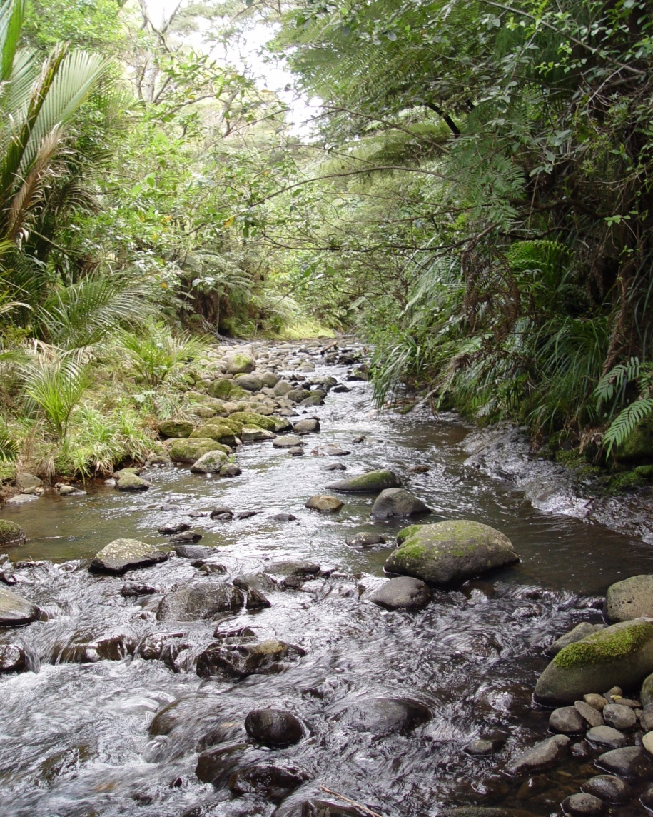
Thank you – Any questions?

Slide 26
Environmental risk assessments
Requirement to understand risk to environment
Risk to project outcomes and success
Quantified to qualitative estimates of risk
Mitigation hierarchy and risk
Enhancement to risk assessment
    Quantified risk modeling (catchment water quality modelling)
    Ranking significance and risk
    Balancing significance and risk

